Slide 1
Tools for Agile Development
Day 2

Slide 2
Outlines
Version Control
Git
Git In-depths
Best Practice

Slide 3
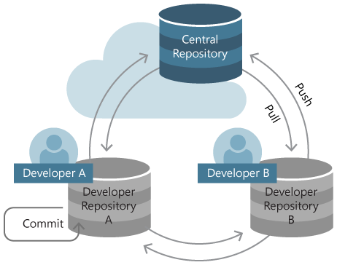
Version Control
Notes:
Intro ประโยชน์ของ Version Control
เล่าการใช้งานจริง
คอนเซป Remote vs Local Repository

Slide 4
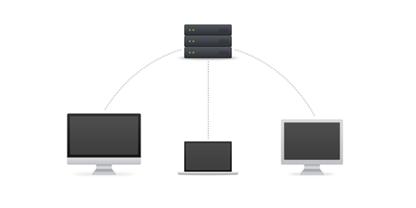
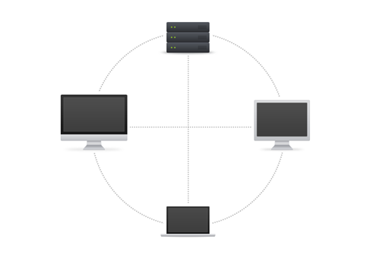
Version Control
Centralized Version Control
Subversion (SVN)
Distributed Version Control
Git
Bitbucket
Mercurial
etc.
Notes:
Centralized
ดี
เข้าใจง่าย ใช้งานง่าย
ควบคุมได้ง่ายกว่า
เสีย
Branching กับ Merging ใช้งานยาก
Decentralized
ดี
Powerful but not simple
Branching กับ Merging เชื่อถือได้
เสีย
ใช้งานยากกว่า เข้าใจยากกว่า
มีโอกาสผิดพลาดเยอะกว่า

Slide 5
Basic Git
Register: https://github.com/
Basic Guide: http://rogerdudler.github.io/git-guide/
Cheat Sheet: https://www.git-tower.com/blog/content/posts/54-git-cheat-sheet/git-cheat-sheet-large01.png http://files.zeroturnaround.com/pdf/zt_git_cheat_sheet.pdf
Try it: https://try.github.io/levels/1/challenges/1

Slide 6
Basic Git
What is Repository?
How does Git work?
The simple Workflow of Git...
Notes:
อันนี้จะ อินโทรเกี่ยวกับตัว Git มันทำงานยังไง และประกอบด้วยอะไรบ้าง Repository
HEAD
Index (staging)
.git
Commit ID
และอธิบาย workflow ง่ายๆ ของการทำงาน

Slide 7
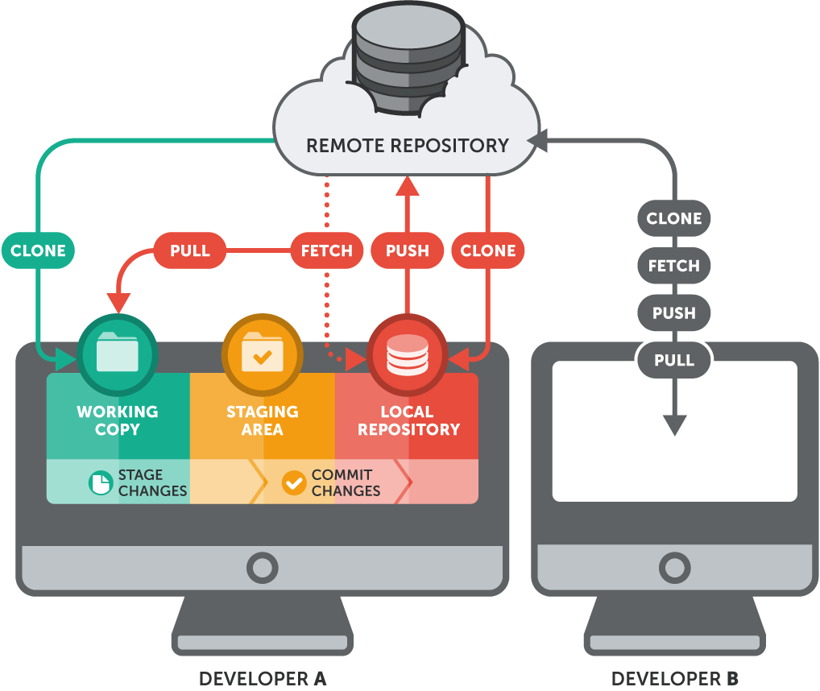
Basic Git
Create
Clone
Check out
Pull
Commit
Push

Slide 8

Basic Git
Branch
Merge
Discard
Rebase

Slide 9
Basic Git
Don’t forget to Writing Good README.md
Ref: https://gist.github.com/PurpleBooth/109311bb0361f32d87a2 Ref: https://github.com/dbader/readme-template

Slide 10
Basic Git
Lab Assignment 1
Create your own folder containing “name_hello.txt” in the provided Repositories
Add your name into “ku-attendance.txt”

Slide 11
Git In-depths
Feature/Hotfix/Release
Tag
Stash
Git Ignore
Forking
Issues & Milestones
Pull Requests
Branch Protection
Insight
Notes:
http://nvie.com/posts/a-successful-git-branching-model/

Slide 12
Git In-depths
Install : Git GUI
Source Tree (https://www.sourcetreeapp.com/)
or
Git Kraken (https://www.gitkraken.com/)

Slide 13

Git In-depths
Feature/Hotfix/Release
Tags
Notes:
คำสั่งเดี๋ยวให้เฮียช่วยดีกว่า

Slide 14
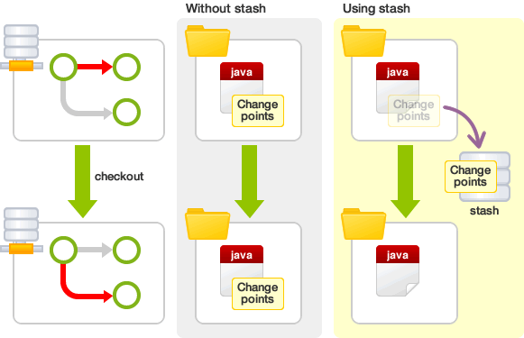
Git In-depths
Stash
Notes:
Use git stash when you want to record the current state of the working directory and the index, but want to go back to a clean working directory. The command saves your local modifications away and reverts the working directory to match the HEAD commit.
Now you want to switch branches, but you don’t want to commit what you’ve been working on yet; so you’ll stash the changes. To push a new stash onto your stack, run git stash:

Slide 15
Git In-depths
What is .gitignore?
How do we write the file?
gitignore.io : https://www.gitignore.io/

Slide 16
Git In-depths
Pattern | Example matches | Explanation*
**/logs | logs/debug.log logs/monday/foo.bar build/logs/debug.log | You can prepend a pattern with a double asterisk to match directories anywhere in the repository.
*.log !important.log | debug.log trace.log but not important.log logs/important.log | Prepending an exclamation mark to a pattern negates it. If a file matches a pattern, but also matches a negating pattern defined later in the file, it will not be ignored.
logs/*day/debug.log | logs/monday/debug.log logs/tuesday/debug.log but not logs/latest/debug.log | Wildcards can be used in directory names as well.
logs/**/debug.log | logs/debug.log logs/monday/debug.log logs/monday/pm/debug.log | A double asterisk matches zero or more directories.
Notes:
https://www.atlassian.com/git/tutorials/gitignore

Slide 17
Git In-depths
Pattern | Example matches | Explanation*
debug?.log | debug0.log debugg.log but not debug10.log | A question mark matches exactly one character.
debug[0-9].log | debug0.log debug1.log but not debug10.log | Square brackets can also be used to match a single character from a specified range.
debug[01].log | debug0.log debug1.log but not debug2.log debug01.log | Square brackets match a single character form the specified set.
debug[!01].log | debug2.log but not debug0.log debug1.log debug01.log | An exclamation mark can be used to match any character except one from the specified set.
Notes:
https://www.atlassian.com/git/tutorials/gitignore
The end , gitignore

Slide 18
Git In-depths
“A fork is a copy of a repository. Forking a repository allows you to freely experiment with changes without affecting the original project.”
Propose changes to someone else's project
or
Use someone else's project as a starting point for your own idea
Notes:
เริ่ม Forking นะจ๊ะ

Slide 19
Git In-depths
Steps
Find the Repo
Hit “Fork”
Clone your fork project
git remote -v
git remote add upstream <original repo>
Opening new Pull Request
Notes:
4. เช็ค repo ของตัว
5. Sync กับ repo ต้นทาง ไว้ fetch มาเพิ่ม
6. เปิด pull request ซะ

Slide 20
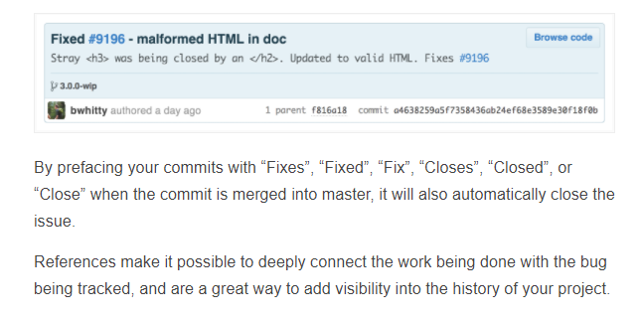
Git In-depths
Issues
Milestones
Notes:
Demo show ไปดีกว่า
Ref : https://guides.github.com/features/issues/

Slide 21
Git In-depths
What is Pull Requests?
“Pull requests let you tell others about changes you've pushed to a GitHub repository. Once a pull request is sent, interested parties can review the set of changes, discuss potential modifications, and even push follow-up commits if necessary.”
Notes:
Demo โชว์ไปซะ คนเดียวสอง users

Slide 22
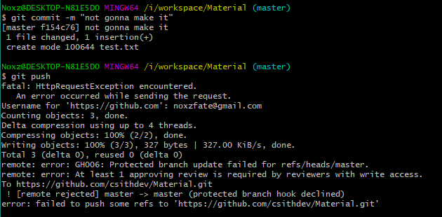
Git In-depths
Branch Protection
Notes:
ต่อจากเมื่อกี๊เลย

Slide 23
Git In-depths
Insights

Slide 24
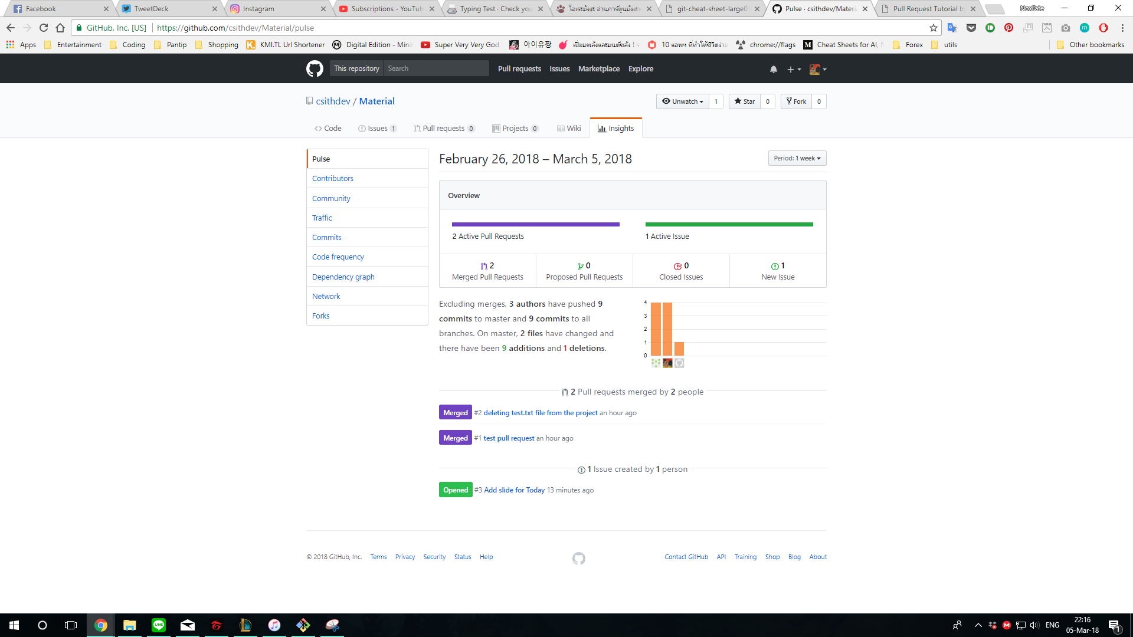

Slide 25
Best Practice
Make small, Understandable commits
Commit often
Don’t commit half-done work
Test before you commit
Write commit messages, explaining your commits
Keeps Branching
Stick with the flow
Do periodic maintenance
Write the README.md
Notes:
Ref
https://www.git-tower.com/learn/git/ebook/en/command-line/appendix/best-practices
https://sethrobertson.github.io/GitBestPractices/

Slide 26
Tips
Watch before you Fork
Octotree Chrome Extension
Insight by Github Chrome Extension
Read the Documentation Carefully

